Slide 1
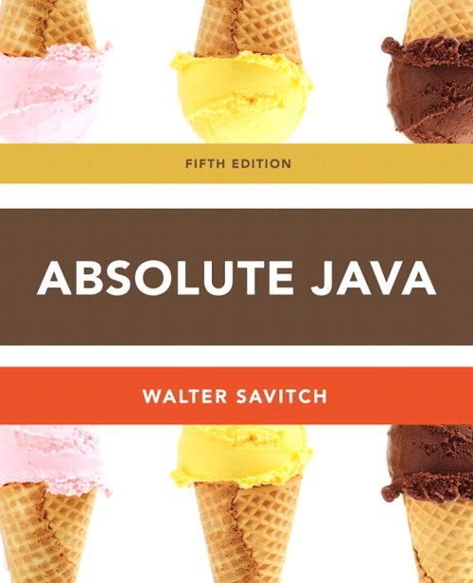
Chapter 1
Section 1.2 Expressions and Assignment Statements
Slides prepared by Rose Williams, Binghamton University
Kenrick Mock, University of Alaska Anchorage

Slide 2
Identifiers
Identifier: The name of a variable or other item (class, method, object, etc.) defined in a program
A Java identifier must not start with a digit, and all the characters must be letters, digits, or the underscore symbol
Java identifiers can theoretically be of any length
Java is a case-sensitive language: Rate, rate, and RATE are the names of three different variables

Slide 3
Identifiers
Keywords and Reserved words: Identifiers that have a predefined meaning in Java
Do not use them to name anything else
public class void static
Predefined identifiers: Identifiers that are defined in libraries required by the Java language standard
Although they can be redefined, this could be confusing and dangerous if doing so would change their standard meaning
System String println

Slide 4
Naming Conventions
Start the names of variables, methods, and objects with a lowercase letter, indicate "word" boundaries with an uppercase letter, and restrict the remaining characters to digits and lowercase letters
topSpeed bankRate1 timeOfArrival
Start the names of classes with an uppercase letter and, otherwise, adhere to the rules above
FirstProgram MyClass String

Slide 5
Variable Declarations
Every variable in a Java program must be declared before it is used
A variable declaration tells the compiler what kind of data (type) will be stored in the variable
The type of the variable is followed by one or more variable names separated by commas, and terminated with a semicolon
Variables are typically declared just before they are used or at the start of a block (indicated by an opening brace { )
Basic types in Java are called primitive types
int numberOfBeans;
double oneWeight, totalWeight;

Slide 6
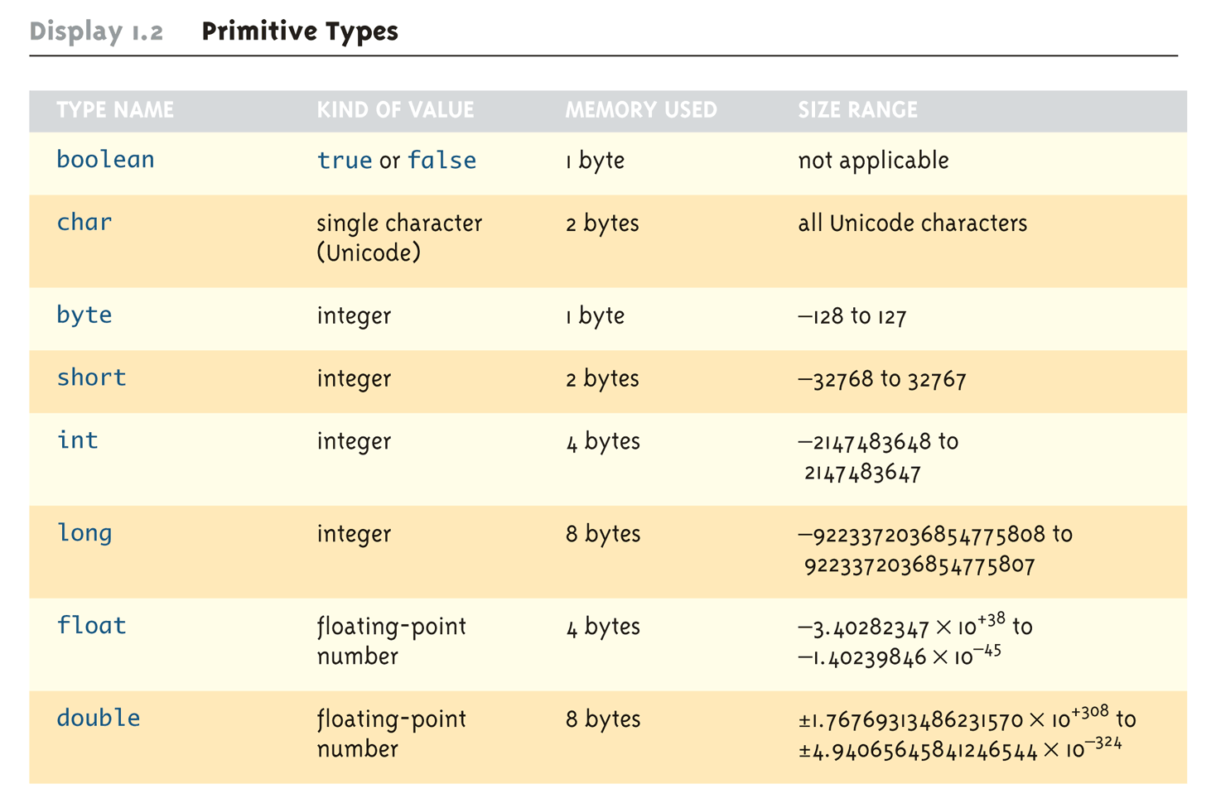
Primitive Types

Slide 7
Assignment Statements With Primitive Types
In Java, the assignment statement is used to change the value of a variable
The equal sign (=) is used as the assignment operator
An assignment statement consists of a variable on the left side of the operator, and an expression on the right side of the operator
Variable = Expression;
An expression consists of a variable, number, or mix of variables, numbers, operators, and/or method invocations
temperature = 98.6;
count = numberOfBeans;

Slide 8
Assignment Statements With Primitive Types
When an assignment statement is executed, the expression is first evaluated, and then the variable on the left-hand side of the equal sign is set equal to the value of the expression
distance = rate * time;
Note that a variable can occur on both sides of the assignment operator
count = count + 2;
The assignment operator is automatically executed from right-to-left, so assignment statements can be chained
number2 = number1 = 3;

Slide 9
Tip: Initialize Variables
A variable that has been declared but that has not yet been given a value by some means is said to be uninitialized
In certain cases an uninitialized variable is given a default value
It is best not to rely on this
Explicitly initialized variables have the added benefit of improving program clarity

Slide 10
Tip: Initialize Variables
The declaration of a variable can be combined with its initialization via an assignment statement
int count = 0;
double distance = 55 * .5;
char grade = 'A';
Note that some variables can be initialized and others can remain uninitialized in the same declaration
int initialCount = 50, finalCount;

Slide 11
Shorthand Assignment Statements
Shorthand assignment notation combines the assignment operator (=) and an arithmetic operator
It is used to change the value of a variable by adding, subtracting, multiplying, or dividing by a specified value
The general form is
Variable Op = Expression
which is equivalent to
Variable = Variable Op (Expression)
The Expression can be another variable, a constant, or a more complicated expression
Some examples of what Op can be are +, -, *, /, or %

Slide 12
Shorthand Assignment Statements
Example: | Equivalent To:
count += 2; | count = count + 2;
sum -= discount; | sum = sum – discount;
bonus *= 2; | bonus = bonus * 2;
time /= rushFactor; | time = time / rushFactor;
change %= 100; | change = change % 100;
amount *= count1 + count2; | amount = amount * (count1 + count2);

Slide 13
Assignment Compatibility
In general, the value of one type cannot be stored in a variable of another type
int intVariable = 2.99; //Illegal
The above example results in a type mismatch because a double value cannot be stored in an int variable
However, there are exceptions to this
double doubleVariable = 2;
For example, an int value can be stored in a double type

Slide 14
Assignment Compatibility
More generally, a value of any type in the following list can be assigned to a variable of any type that appears to the right of it
byte→short→int→long→float→double
char
Note that as your move down the list from left to right, the range of allowed values for the types becomes larger
An explicit type cast is required to assign a value of one type to a variable whose type appears to the left of it on the above list (e.g., double to int)
Note that in Java an int cannot be assigned to a variable of type boolean, nor can a boolean be assigned to a variable of type int

Slide 15
Constants
Constant (or literal): An item in Java which has one specific value that cannot change
Constants of an integer type may not be written with a decimal point (e.g., 10)
Constants of a floating-point type can be written in ordinary decimal fraction form (e.g., 367000.0 or 0.000589)
Constant of a floating-point type can also be written in scientific (or floating-point) notation (e.g., 3.67e5 or 5.89e-4)
Note that the number before the e may contain a decimal point, but the number after the e may not

Slide 16
Constants
Constants of type char are expressed by placing a single character in single quotes (e.g., 'Z')
Constants for strings of characters are enclosed by double quotes (e.g., "Welcome to Java")
There are only two boolean type constants, true and false
Note that they must be spelled with all lowercase letters

Slide 17
Arithmetic Operators and Expressions
As in most languages, expressions can be formed in Java using variables, constants, and arithmetic operators
These operators are + (addition), - (subtraction), * (multiplication), / (division), and % (modulo, remainder)
An expression can be used anyplace it is legal to use a value of the type produced by the expression

Slide 18
Arithmetic Operators and Expressions
If an arithmetic operator is combined with int operands, then the resulting type is int
If an arithmetic operator is combined with one or two double operands, then the resulting type is double
If different types are combined in an expression, then the resulting type is the right-most type on the following list that is found within the expression
byte→short→int→long→float→double
char
Exception: If the type produced should be byte or short (according to the rules above), then the type produced will actually be an int

Slide 19
Parentheses and Precedence Rules
An expression can be fully parenthesized in order to specify exactly what subexpressions are combined with each operator
If some or all of the parentheses in an expression are omitted, Java will follow precedence rules to determine, in effect, where to place them
However, it's best (and sometimes necessary) to include them

Slide 20
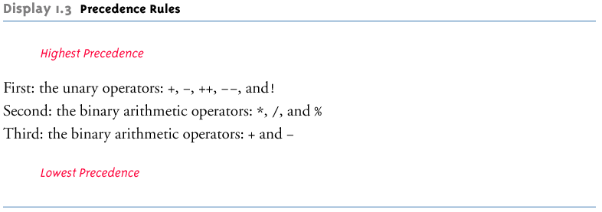
Precedence Rules

Slide 21
Precedence and Associativity Rules
When the order of two adjacent operations must be determined, the operation of higher precedence (and its apparent arguments) is grouped before the operation of lower precedence
base + rate * hours is evaluated as
base + (rate * hours)
When two operations have equal precedence, the order of operations is determined by associativity rules

Slide 22
Precedence and Associativity Rules
Unary operators of equal precedence are grouped right-to-left
+-+rate is evaluated as +(-(+rate))
Binary operators of equal precedence are grouped left-to-right
base + rate + hours is evaluated as
(base + rate) + hours
Exception: A string of assignment operators is grouped right-to-left
n1 = n2 = n3; is evaluated as n1 = (n2 = n3);

Slide 23
Pitfall: Round-Off Errors in Floating-Point Numbers
Floating point numbers are only approximate quantities
Mathematically, the floating-point number 1.0/3.0 is equal to 0.3333333 . . .
A computer has a finite amount of storage space
It may store 1.0/3.0 as something like 0.3333333333, which is slightly smaller than one-third
Computers actually store numbers in binary notation, but the consequences are the same: floating-point numbers may lose accuracy

Slide 24
Integer and Floating-Point Division
When one or both operands are a floating-point type, division results in a floating-point type
15.0/2 evaluates to 7.5
When both operands are integer types, division results in an integer type
Any fractional part is discarded
The number is not rounded
15/2 evaluates to 7
Be careful to make at least one of the operands a floating-point type if the fractional portion is needed

Slide 25
The % Operator
The % operator is used with operands of type int to recover the information lost after performing integer division
15/2 evaluates to the quotient 7
15%2 evaluates to the remainder 1
12%30 evaluates to the remainder 12
The % operator can be used to count by 2's, 3's, or any other number
To count by twos, perform the operation number % 2, and when the result is 0, number is even

Slide 26
Type Casting
A type cast takes a value of one type and produces a value of another type with an "equivalent" value
If n and m are integers to be divided, and the fractional portion of the result must be preserved, at least one of the two must be type cast to a floating-point type before the division operation is performed
double ans = n / (double)m;
Note that the desired type is placed inside parentheses immediately in front of the variable to be cast
Note also that the type and value of the variable to be cast does not change

Slide 27
More Details About Type Casting
When type casting from a floating-point to an integer type, the number is truncated, not rounded
(int)2.9 evaluates to 2, not 3
When the value of an integer type is assigned to a variable of a floating-point type, Java performs an automatic type cast called a type coercion
double d = 5;
In contrast, it is illegal to place a double value into an int variable without an explicit type cast
int i = 5.5; // Illegal
int i = (int)5.5 // Correct

Slide 28
Increment and Decrement Operators
The increment operator (++) adds one to the value of a variable
If n is equal to 2, then n++ or ++n will change the value of n to 3
The decrement operator (--) subtracts one from the value of a variable
If n is equal to 4, then n-- or --n will change the value of n to 3

Slide 29
Increment and Decrement Operators
When either operator precedes its variable, and is part of an expression, then the expression is evaluated using the changed value of the variable
If n is equal to 2, then 2*(++n) evaluates to 6
When either operator follows its variable, and is part of an expression, then the expression is evaluated using the original value of the variable, and only then is the variable value changed
If n is equal to 2, then 2*(n++) evaluates to 4

